Slide 1
Research Problem and Research Question

Slide 2
Agenda
Turnitin…
Research Problem
Research Question
The nature of reality!

Slide 3
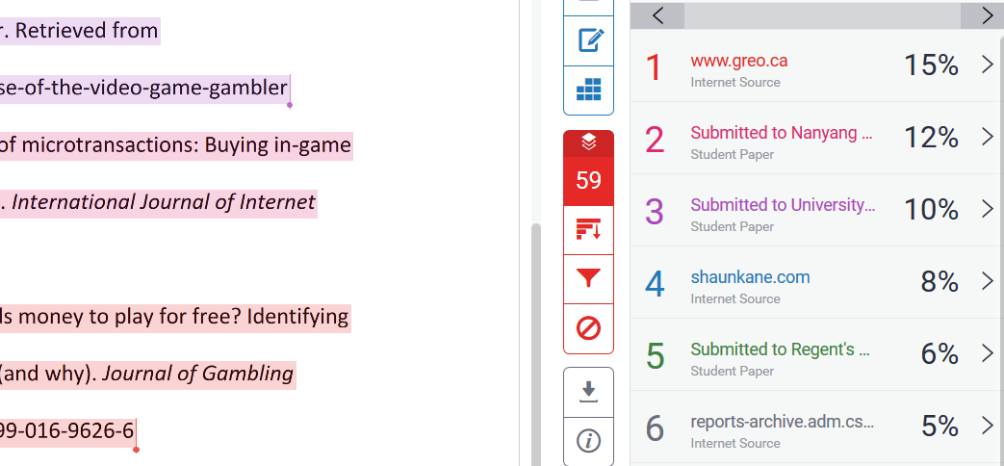
Turnitin Example
In this example the overall similarity was 57%

Slide 4
Turnitin Example
2
When you write a section of text for submitting to Turnitin it is likely that some small parts of the text may be similar to those existing in other documents. This is particularly true where technical terms are used in combination with common text constructions, or where you use headings, titles or other commonly used phrases. As said by Vos (2019) there are only so many ways to say “the cat sat on the table”. Where phrases you have written appear in other documents these will be highlighted by Turnitin. You need to decide whether or not to further paraphrase the material presented.
3

Slide 5
The Research Problem
Research problems are the issues, controversies or concerns of a particular discipline
In research reports you will find the problem defined in the introduction of the study
Literature review supports the research problem
Not all problems can, or should be researched due to:
Time
Resources
Skill
Access…

Slide 6
Developing Research Problem
A research problem is a clear statement about an area of interest that exists in literature or theory.
The research problem points toward an area that requires further research and investigation.
Research problems range from simple to complex depending on the number of variables and/or the nature of relationships
Research problems justify the usefulness of the research
Research problems do not state how to do the research, or present a question.

Slide 7
Finding a Research Problem
Research problems arise from literature investigation (or discussion) which identifies:
Gaps in knowledge
Differences between action and theory
Theoretical conflict
Contradiction in evidence
Research agendas
Personal experience

Slide 8
In a BYOD program, employees use their own personal mobile devices to conduct business within the organisation. Allowing employees to use their own devices takes device control away from the organisation. Organisational data stored on personal devices is at risk due to malware and information leaks, most notably resulting from the loss or theft of the device. A study conducted by Gartner (2015) finds that organisations should obtain an employee’s consent to remotely wipe their device in the event of a security breach. Gartner also recommends whitelisting and blacklisting certain applications and software. However, there is a lack of research understanding how employees would react to such a programme. Therefore this research…

Slide 9

The Research Question
Drives the research
Clearly identifies the problem
Derived from the literature review and research problem
Can dictate both theory and method

Slide 10
Developing Research Question
Pick the topic
Narrow the topic
List some questions
Pick a question
Focus the question

Slide 11
Good Research Questions
Good research questions are:
Specific – includes the variable being researched and possibly the method/theory.
The answers provide usable data/ be researchable.
Should have some connection to literature and theory.
If more than one question, they should be linked.
Should not be too broad, or too narrow.
Are derived from a research problem.

Slide 12
Writing Research Questions
Ask open ended “how” “what” “why” questions.
Identify/name the dependent variable – or the thing you are researching.
Identify the group/s involved – and where in the question they come.
Include method/theory if relevant
Include context if relevant.
What kind of research are you conducting?
Don’t imply the answer in the question.

Slide 13
Why did the chickens cross the road?
Why did chickens cross Dixon Street in 2017?
Why are chickens crossing the road hazardous?
How many chickens crossed Dixon Street on 3 March 2017?
What factors occurred on Dixon Street during March 2017, that caused chickens to cross the road?

Slide 14
Exercise
Consider your research problem – what research might arise from your literature review.
List a few possible research questions.
Discuss with your neighbor…

